Slide 1

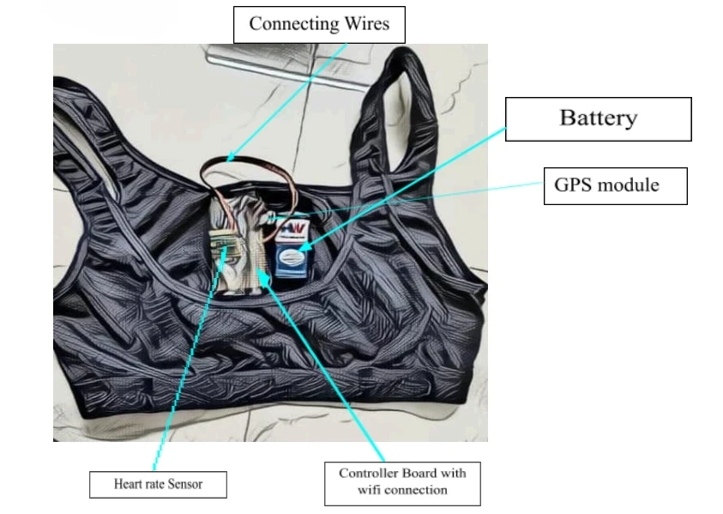


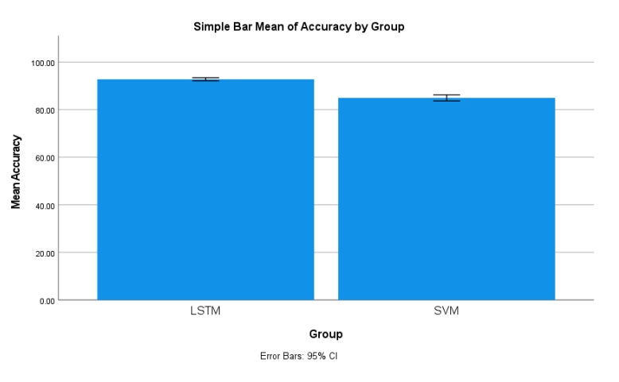
Register No: 192111281
Students Name: Sammireddy Aswini
Guided By Dr. Gokul Gopan
Health and Position Tracking System for Disaster Response with one-class SVM in Comparison with LSTM for Improved Accuracy
INTRODUCTION
The system is designed to provide real-time monitoring of health status and geographical location for first responders during disaster scenarios.
It overcomes the limitations of conventional tracking systems by leveraging advanced machine learning techniques, specifically comparing One-Class SVM and LSTM, to improve detection accuracy and responsiveness in unpredictable environments.
The architecture is built with robust components such as the MAX30100 pulse oximeter sensor, ESP8266 Wi-Fi module, and GPS 6NEO, ensuring precise real-time health and position tracking.
The integration of deep learning, particularly LSTM models, is evaluated against One-Class SVM to assess which algorithm provides superior anomaly detection and reliability in critical scenarios.
This system contributes significantly to the evolution of intelligent emergency response technologies.
Real-Time Health and Position Tracking System
MATERIALS AND METHODS
MAX30100 Heart Rate Sensor
Rechargeable Battery
ESP8266 Wi-Fi Module
Wireless Data Transmission
Rescue Team Monitoring Station
Neo-6M GPS Module
RESULTS
 | Algorithm | N | Mean | Std. Deviation | Std. Error Mean
Accuracy | LSTM | 20 | 92.7900 | 1.35759 | 0.30357
 | SVM | 20 | 84.9650 | 2.76810 | 0.61897
LSTM VS SVM
ACCURACY VALUES OF LSTM VS SVM
The study compares Support Vector Machine (SVM) and LSTM over 20 iterations (N = 20), using G*Power parameters set at α = 0.05 and power = 0.85 to ensure statistical validity.
LSTM outperforms SVM, achieving a higher mean accuracy (92.79% vs. 84.96%), along with a lower standard deviation and smaller standard error mean, indicating greater accuracy and consistency.
The findings highlight that algorithm performance varies by dataset, with LSTM showing superior results for real-time health and position tracking in disaster response scenarios.
DISCUSSION AND CONCLUSION
The system compares Long Short-Term Memory (LSTM) and Support Vector Machine (SVM) for real-time health and position tracking of first responders using input data such as heart rate, GPS coordinates, and environmental data.
One-Class SVM is well-suited for anomaly detection in unlabeled or semi-supervised datasets, but it has limitations in capturing temporal dynamics, which are crucial in fast-changing disaster response environments.
LSTM, with its capability for sequential learning, excels in modeling time-series data, enabling it to detect early signs of health deterioration and movement anomalies by learning temporal dependencies.
In comparative evaluations, LSTM achieved a higher accuracy of 92.79%, significantly outperforming One-Class SVM, which achieved 84.96%, demonstrating LSTM’s superiority in temporal pattern recognition and anomaly detection.
The results highlight LSTM’s effectiveness for real-time applications, offering faster and more reliable tracking, better situational awareness, and improved decision-making support in high-risk disaster zones.
The integration of wearable sensors with LSTM-based analytics provides a scalable and responsive solution aligned with mission-critical objectives such as first responder safety and operational efficiency.
BIBLIOGRAPHY
Babu, P., & Jayaraman, M. (2022). "Development of a wearable health monitoring device for disaster situations." International Journal of Health Sciences, 16(1), 34–44.
Chen, C., & Zhang, Y. (2020). " Integration of GPS and heart rate monitoring in disaster management. " Journal of Emergency Management, 18(2), 113–120.
Dey, A., & Ahsan, M. (2019). " Health monitoring system using MAX30100 sensor. " International Journal of Computer Applications, 182(8), 6–12.
Ismail, I., & Ali, F. (2021). " Real-time disaster response using IoT technologies: A comprehensive study. " International Journal of Disaster Risk Reduction, 59, 102–112.
Wei, Y., & Zhao, X. (2018). " Design and implementation of a disaster response system based on GPS technology. " IEEE Access, 6, 47087–47097.

